Slide 1
A Mighty Empire
ROME
Author: Kathryn J Kavanagh
Notes:
http://www.nms.ac.uk/kids/people_of_the_past/discover_the_romans.aspx

Slide 2
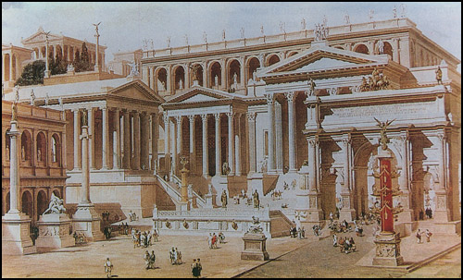
Ancient Rome has a grand history, spanning hundreds of years and over half of Europe. The now sprawling city started as a small village on the banks of the Tibet River . Evidence shows that Rome was once seven small but distinct districts known as the Seven Hills of Rome.
Image retrieved from: http://www.spartacus.schoolnet.co.uk/ROMrome.htm
What else do you know about Rome? Check out these interesting facts!
Notes:
http://www.historylearningsite.co.uk/a_history_of_ancient_rome.htm
http://www.oklahomahomeschool.com/pdf%20documents/RomeTLPcs.pdf
http://www2.luthersem.edu/ckoester/Paul/journey4/RomeTiber.htm
http://www.spartacus.schoolnet.co.uk/ROMrome.htm
http://www.musesrealm.net/rome/sevenhills.html
http://facts.randomhistory.com/2009/03/07_rome.html

Slide 3
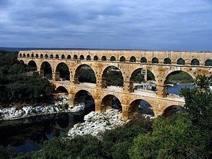
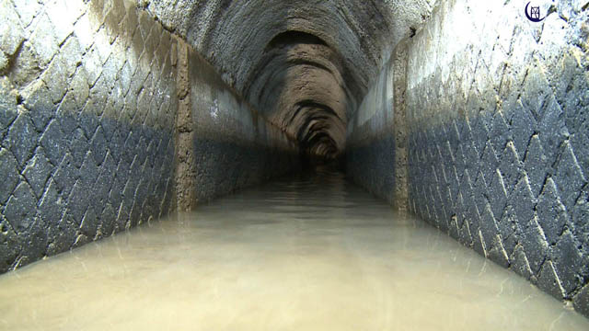
The Romans most recognised
achievement was their
invention of aqueducts.
The romans believed that their
health was linked to their
ability to access fresh
sustainable supplies of water,
so they created these arching
structures and tunnels to
Transport fresh water from
springs kilometres away.
Images retrieved from: http://aqueducthunter.com/fiora/fiora7.html and http://en.wikipedia.org/wiki/Roman_aqueduct
Notes:
http://www.youtube.com/watch?v=wmyrpMtBWf8
http://up2meforkids.com.au/popup6.php?Do=ContentView&pageno=174
http://www.pbs.org/wgbh/nova/lostempires/roman/aqueduct.html
http://www.youtube.com/watch?v=qiE0pi99z-A

Slide 4
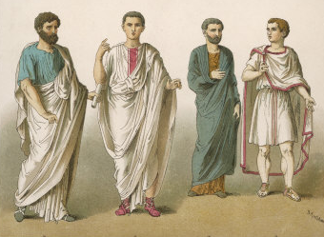
The People of Rome
Ancient Rome was a very class-conscious society and every member, from the slaves to the senators, had their place. There were many differences between the lower and upper classes including the clothing they wore,
the types of housing
they could live in and
the meals they would
eat.
What type of Roman
Citizen would you be?
Image retrieved from: http://www.allposters.ie/-sp/Ancient-Rome-Clothing-Worn-by-a-Public-Orator-posters_i1870848_.htm
Notes:
http://www.vroma.org/~bmcmanus/socialclass.html
http://www.youtube.com/watch?v=ZmCtx11izBQ

Slide 5
Men and women both had specific roles in Roman society, which corresponded to the work they would do. Regardless of class, a woman’s job was to prepare the house and keep the man happy.
Women from wealthy families were in
charge of making sure the slaves kept
the house clean and had the food
prepared for the men. The men were
free to get jobs.
Images retrieved from: http://rachelderozario.wordpress.com/category/ancient-rome/
Notes:
http://rome.mrdonn.org/women.html
http://www.roman-empire.net/society/society.html
http://ancientlinks.blogspot.com.au/2010/11/jobs-in-ancient-rome-introduction.html

Slide 6
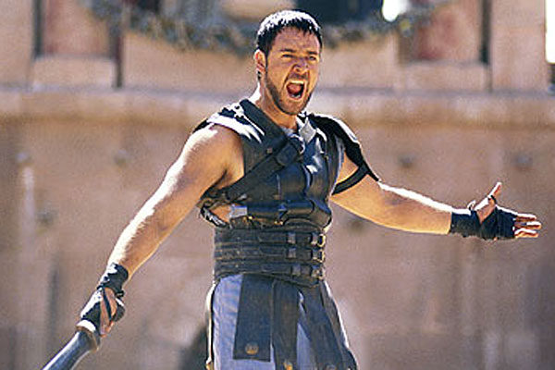
Slaves and Gladiators
Slaves were incredibly important to the Romans and it was a sign of wealth if you owned a slave. Strong male slaves were often brought by wealthy men wanting to train them to become gladiators.
Gladiators are trained fighters who were once slaves. They fought in great battles where they were forced to fight to the death.
What kind of
gladiator would you be?
Image retrieved from: http://vaughnroycroftblog.com/tag/gladiator/
Notes:
http://www.historylearningsite.co.uk/roman_slaves.htm
http://www.bbc.co.uk/history/ancient/romans/gladiators_01.shtml
http://library.thinkquest.org/J0112842/
http://www.salariya.com/web_books/gladiator/index.html

Slide 7
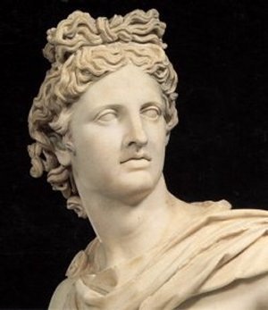
Religion
The Romans had a number of gods which they would worship and make sacrifices to. They believed the gods were responsible for the events that happened, both good and bad. Often, the army generals would pray to the gods before going to war to secure a win.
There were so many gods to
remember, special priests would
accompany the army to make sure
the right gods were honoured.
Now you try. Design your own
Roman god!
Image retrieved from: http://blog.lib.umn.edu/deg/campfire/2010/03/the-god-wars---35.html
Notes:
http://rome.mrdonn.org/romangods/index.html
http://www.youtube.com/watch?v=ezpn8xH_XHI

Slide 8
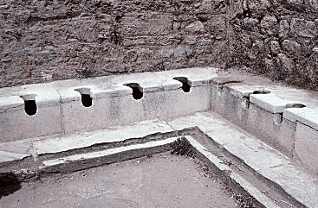
Roman Amenities
Romans were all about being clean and healthy citizens, as they believed a healthy body lead to a healthy mind. Romans are famous for their communal toilets which were used by those from all classes. The romans used the water brought into the cities by aqueducts to wash away the sewage.
Image retrieved from: http://davidmarkbrownwrites.com/crapper-a-visual-history/
Notes:
http://www.pbs.org/wgbh/nova/lostempires/roman/day.html
http://www.youtube.com/watch?v=6snVyK6gQCE

Slide 9
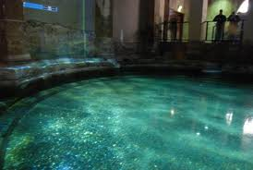
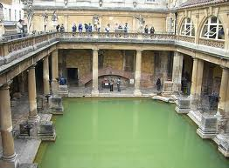
Another amenity available to the masses were the bath houses, some of which can still be visited today. These were places where the people could go to wash themselves, to work out or to relax and talk about business.
Image retrieved from: http://fc.francisparker.org/~mbabla2013/FramesetBath.htm and http://blog.francinekizner.com/tag/roman-baths/
Notes:
http://www.romanbaths.co.uk/walkthrough.aspx

Slide 10
Entertainment
Entertaining was one of the romans favourite pastime, and they always put on a grand event. The Colosseum was the centre of all Roman entertainment. The various events held there included gladiator battles, theatre and circus performances, public trials such as hangings and markets.
What similar kinds of entertainment do we see these days?
Image retrieved from: http://wilsonancientrome.wikispaces.com/Roman+Theater
Notes:
http://www.wjcc.k12.va.us/tms/curriculum/history/rome/andy/andyent1.html
http://www.bbc.co.uk/history/ancient/romans/launch_ani_colosseum.shtml
http://www.youtube.com/watch?v=-NTbGawBvc4

Slide 11
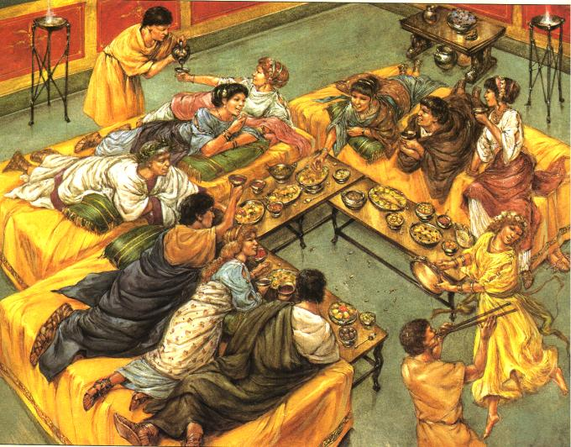
Dinner parties, private gatherings and celebrations were also common in ancient Rome. Food, wine and music all played a large role in the Roman culture. There were often month long celebrations held for wedding, births
or funerals.
What would you include
if you held a Roman
dinner party?
Image retrieved from: http://outre-monde.com/2012/07/24/the-roman-dinner-party/
Notes:
http://www.youtube.com/watch?v=jV0oA3YUiw8
http://www.youtube.com/watch?v=yLVnFEXnHB8

Slide 12
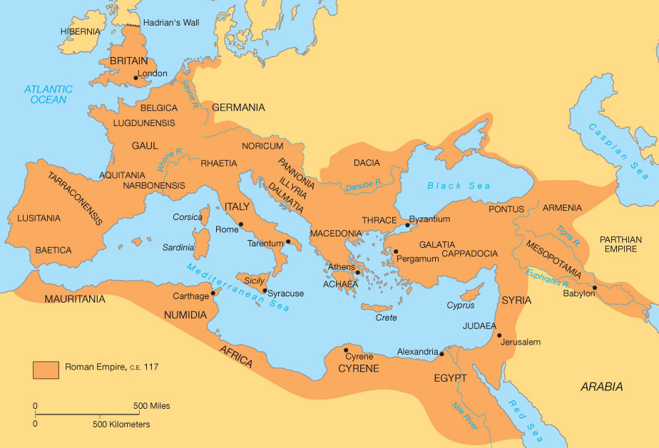
The Roman Empire
The Roman’s were an ambitious nation and over the years the Roman empire grew to become one of the largest empires ever known.
The Roman empire was made up of many provinces, territories and tribes. As a reward for their courage, generals were often given areas of land to govern.
Image retrieved from: http://www.personal.psu.edu/asg198/Final%20Project/romanempire.html
Notes:
http://www.roman-empire.net/maps/map-empire.html
http://www.livius.org/gi-gr/governor/provinces.html

Slide 13
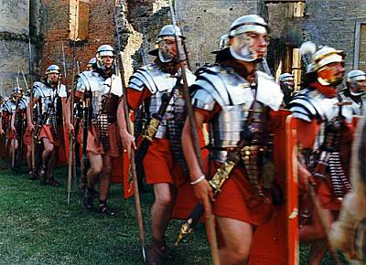
Roman Armies
The Roman empire owed its success to its extensive armies, which helped to conquer and control captured areas as well as defend the roman empire.
These armies were made up of hundreds of thousands of well armed and highly skilled soldiers.
Image retrieved from: http://www.lore-and-saga.co.uk/html/romans.html
Notes:
http://www.brims.co.uk/romans/army.html
http://www.schoolsliaison.org.uk/kids/romancent.htm

Slide 14
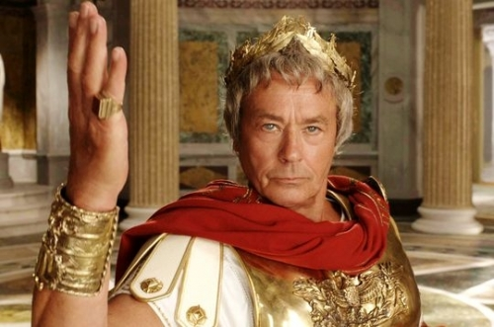
Roman Rulers
Rome had many leaders who
were referred to as Emperors.
These men were in charge
of the Roman government and made sure the empire grew and flourished. However, many of these rulers are more famous for the horrible things they did.
The most famous was emperor Julius Caesar who was assassinated by his own government on the steps of parliament.
Image retrieved from: http://www.listal.com/list/actors-have-played-ancient-romans
Notes:
http://www.livius.org/ei-er/emperors/emperors01.html
http://www.youtube.com/watch?v=u0_z-MbODVo
http://www.pbs.org/empires/romans/empire/julius_caesar.html
http://www.youtube.com/watch?v=eyq8uWvpbt4

Slide 15
Year 7 – The Ancient World
The physical features of ancient Rome (such as the River Tiber) and how they influenced the civilisation that developed there. | > Describing the methods used by the Romans to manage resources
Roles of key groups in ancient Roman society (such as patricians, plebeians, women, slaves), including the influence of law and religion. | > Examining the evidence of the social structure of Roman society and the idea of Republican virtue and its historical resonance > Describing the significance of slavery in the period of the Roman Empire
The significant beliefs, values and practices of the ancient Romans, with a particular emphasis on ONE of the following areas: everyday life, warfare, or death and funerary customs. | > Investigating significant beliefs associated with daily life practices
Contacts and conflicts within and/or with other societies, resulting in developments such as the expansion of trade, the rise of the Roman empire (including its material remains), and the spread of religious beliefs. | > Describing the furthest extent of the Roman Empire and the influence of foreign cults on Roman religious beliefs and practices > Reading accounts of contacts between Rome and Asian societies in the ancient period.
The role of a significant individual in ancient Rome’s history such as Julius Caesar or Augustus | > Examining the historical context, early life and achievements of a significant historical figure from ancient Rome, and how they were perceived by their contemporaries
The History Curriculum References
Notes:
http://www.australiancurriculum.edu.au/Year7?a=H&layout=1

